Slide 1
Chapter 4
Network Basics

Slide 2
Moving Data Around
IP Addresses
4 sets of Octets, 32 Bits total
Layer 3 – Routers
Mac Addresses
6 pairs of Hexa-decimal numbers
First 3 Pairs, Identifies company
Last 3 Pairs, randomized by company
Layer 2 - Switches
Notes:
4 octets = 32 bit for IPv4
IP addresses are used at Layer 3 w/ Routers and Smart Switches
Passing data over the internet
MAC address is a hardware address, if devices are on the same LAN, a switch or hub will use the MAC address to determine the destination of data
Always associate MAC addresses with Layer 2 switches
Chapter 6 we’ll cover the relationship between a MAC address and IP addresses

Slide 3
Ethernet Basics
Collision Domains
Layer 1 – All
Layer 2 – Per Interface
Layer 3 – Per Interface
Broadcast Domains
Layer 1 – All
Layer 2 – Per Network
Layer 3 – Per Interface
Notes:
Collison domains are occur when multiple devices attempt to send traffic at the same time, thereby creating a collision
In a collision domain all devices are attempting to transmit data over one single link
Collisions have a negative effect on the performance of network traffic, think of how long it takes you to get somewhere when there is multiple accidents on 95
Accidents are things you want to avoid right?
In Broadcast domains traffic flows throughout the entire network
The broadcast domain represents a logical/virtual set of devices that are reachable without a router
No collisions occur in the broadcast domains

Slide 4
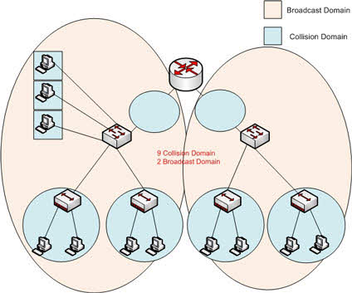

Slide 5
Carrier Sense Multiple Access (CSMA)
Collision Detection
802.3
Collision Avoidance
802.11
Notes:
CSMA/CD: Collision detection, think wired connections
The way it works is it’ll send a signal, recognize transmission is already being because signal, then it’ll wait on a specified time to send that data again
CSMA/CA: The way it works is, before transmitting data, it checks to see if data is being sent, if there is nothing being sent, then it will send
If it detects a signal, a busy tone is basically given to all other hosts to wait until it is done transmitting information
The busy signal has a timer and once the timer expires, any host has equal opportunity to begin their transmission
This causes delays, low throughput, and congestion (SLOW)

Slide 6
Ethernet Terminology
Broadband
Multiple frequencies of different signals on the same line
Used to carry voice and data traffic
Baseband
One signal all the bandwidth
Used for Internet/Networking (Think Cat5e)
Bit Rate
Number of Data Bits transferred per second
Baud Rate
Number of Characters transferred per second
Wavelength
Size of the wave in an analog signal
Notes:
Broadband allows you to send both analog and digital signals over the same physical cable
Broadband has frequency-division multiplexing; that allows you to send multiple frequencies on the same wire at the same time
Baseband uses all bandwidth and can only send one signal, all LANs use it
This setup causes collisions, because multiple signals are not able to be sent at the same time
Bit rate- number of 1s and 0s transmitted per second in either a digital or analog signal
78,000 would represent how many 1s and 0s can be transmitted per second
Baud rate is the unit number of signals per second
Wavelength, when it gets charted out on a graph, is the distance between its high points

Slide 7
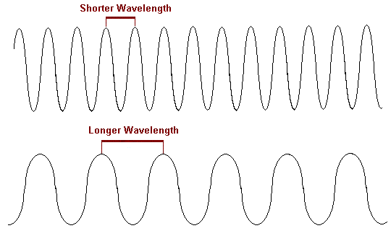
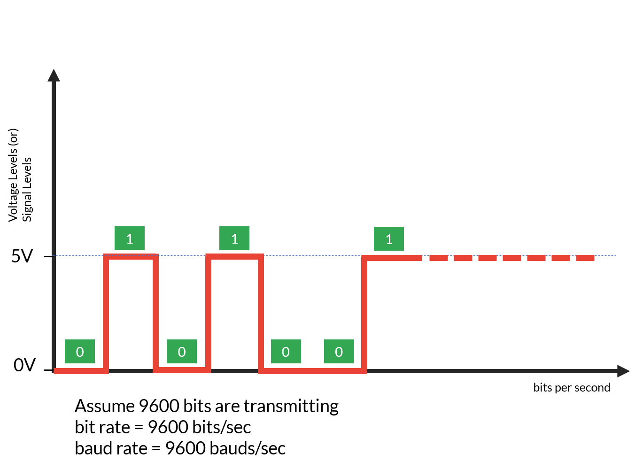

Slide 8
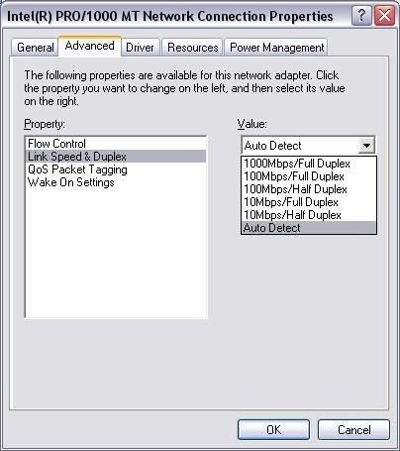
Sending Data
Full Duplex
Both directions
Half Duplex
One way at a time
Simplex
One way only

Slide 9
Binary and hexadecimal Numbers
WE WILL COME BACK TO THIS!

Slide 10

IEEE Ethernet Standards
100Base-TX (IEEE 802.3u)
commonly known as Fast Ethernet
uses Category 5, 5E, or 6, UTP two-pair wiring.
One user per segment; up to 100 meters long.
uses an RJ-45 connector.
100Base-FX (IEEE 802.3u)
Uses fiber cabling 62.5/125-micron multimode fiber.
Point-to-point topology
412 meters long.
uses ST and SC connectors
1000Base-CX (IEEE 802.3z)
Copper twisted-pair called twinax (a balanced coaxial pair)
can run only up to 25 meters and uses a special 9-pin connector known as the High Speed Serial Data Connector (HSSDC).
1000Base-T (IEEE 802.3ab)
Category 5, four-pair UTP wiring up to 100 meters long.
Notes:
100 represents the speed in Mbps, the word base is saying its baseband, TX represents it being Twisted pair (Fast Ethernet), Cat 5, 5e, or 6 two-pair wiring
100 represent the speed in Mbps, base is baseband, but FX represents fiber. F always represents fiber. MMF. FX uses laser components to transmit light
1000BaseCX uses a twinax running up to 25m and uses a High-Speed Serial Data Connector
1000Base-T is 1GB/s or 1000Mbps speed. Uses at least Cat5 4pair wiring

Slide 11
IEEE Standards (cont.)
1000Base-SX (IEEE 802.3z)
Gigabit Ethernet running over multimode fiber
Multimode fiber (MMF) using 62.5- and 50-micron core
can go up to 220 meters with 62.5-micron, 550 meters with 50-micron.
1000Base-LX (IEEE 802.3z)
Single-mode fiber that uses a 9-micron core
can go from 3 km up to 10 km.
10GBase-T
10Gbps connections over conventional UTP cables
allows the conventional RJ-45 used for Ethernet LANs.
supports signal transmission at the full 100-meter distance specified for LAN wiring.
Notes:
1000Base-SX is 1Gbps over MMF, using LED light to transmit, uses a shorter wavelength laser
1000Base-LX is 1Gbps over SMF, uses longer wavelength laser, MMF can be up to 550m or SMF 3km
10GBase-T, uses 10Gbps over high frequency, requires a minimum of Cat6, UTP distance is 55m and STP is 100m, Cat6A (augmented) supports 100m shielded or unshielded
Anything with a T is twisted pair, S/L/E are all fiber

Slide 12
IEEE Standards (cont.)
10GBase-SR
multimode fiber.
maximum transmission distance of between 2 and 300 meters, depending on the size and quality of the fiber.
10GBase-LR
single-mode fiber.
maximum transmission distance between 2 meters and 10 km, depending on the size and quality of the fiber.
10GBase-ER
single-mode fiber.
anywhere from 2 meters up to 40 km, depending on the size and quality of the fiber used.
Notes:
Short range fiber (SR); MMF; 25-400m
Long range fiber (LR); SMF; 10km
Extra-Longe range fiber (ER); 40km

